Slide 1

Energy Aware Simulations
Benjamin Czaja
HPC Advisor SURF
April 2024

Slide 2
https://ondemand.snellius.surf.nl/

Slide 3
https://github.com/sara-nl/energy-efficient-computing login: scur0311 Reservation: jupyterhub_course_jhssrf009_2024-04-18

Slide 4
scur0311

Slide 5
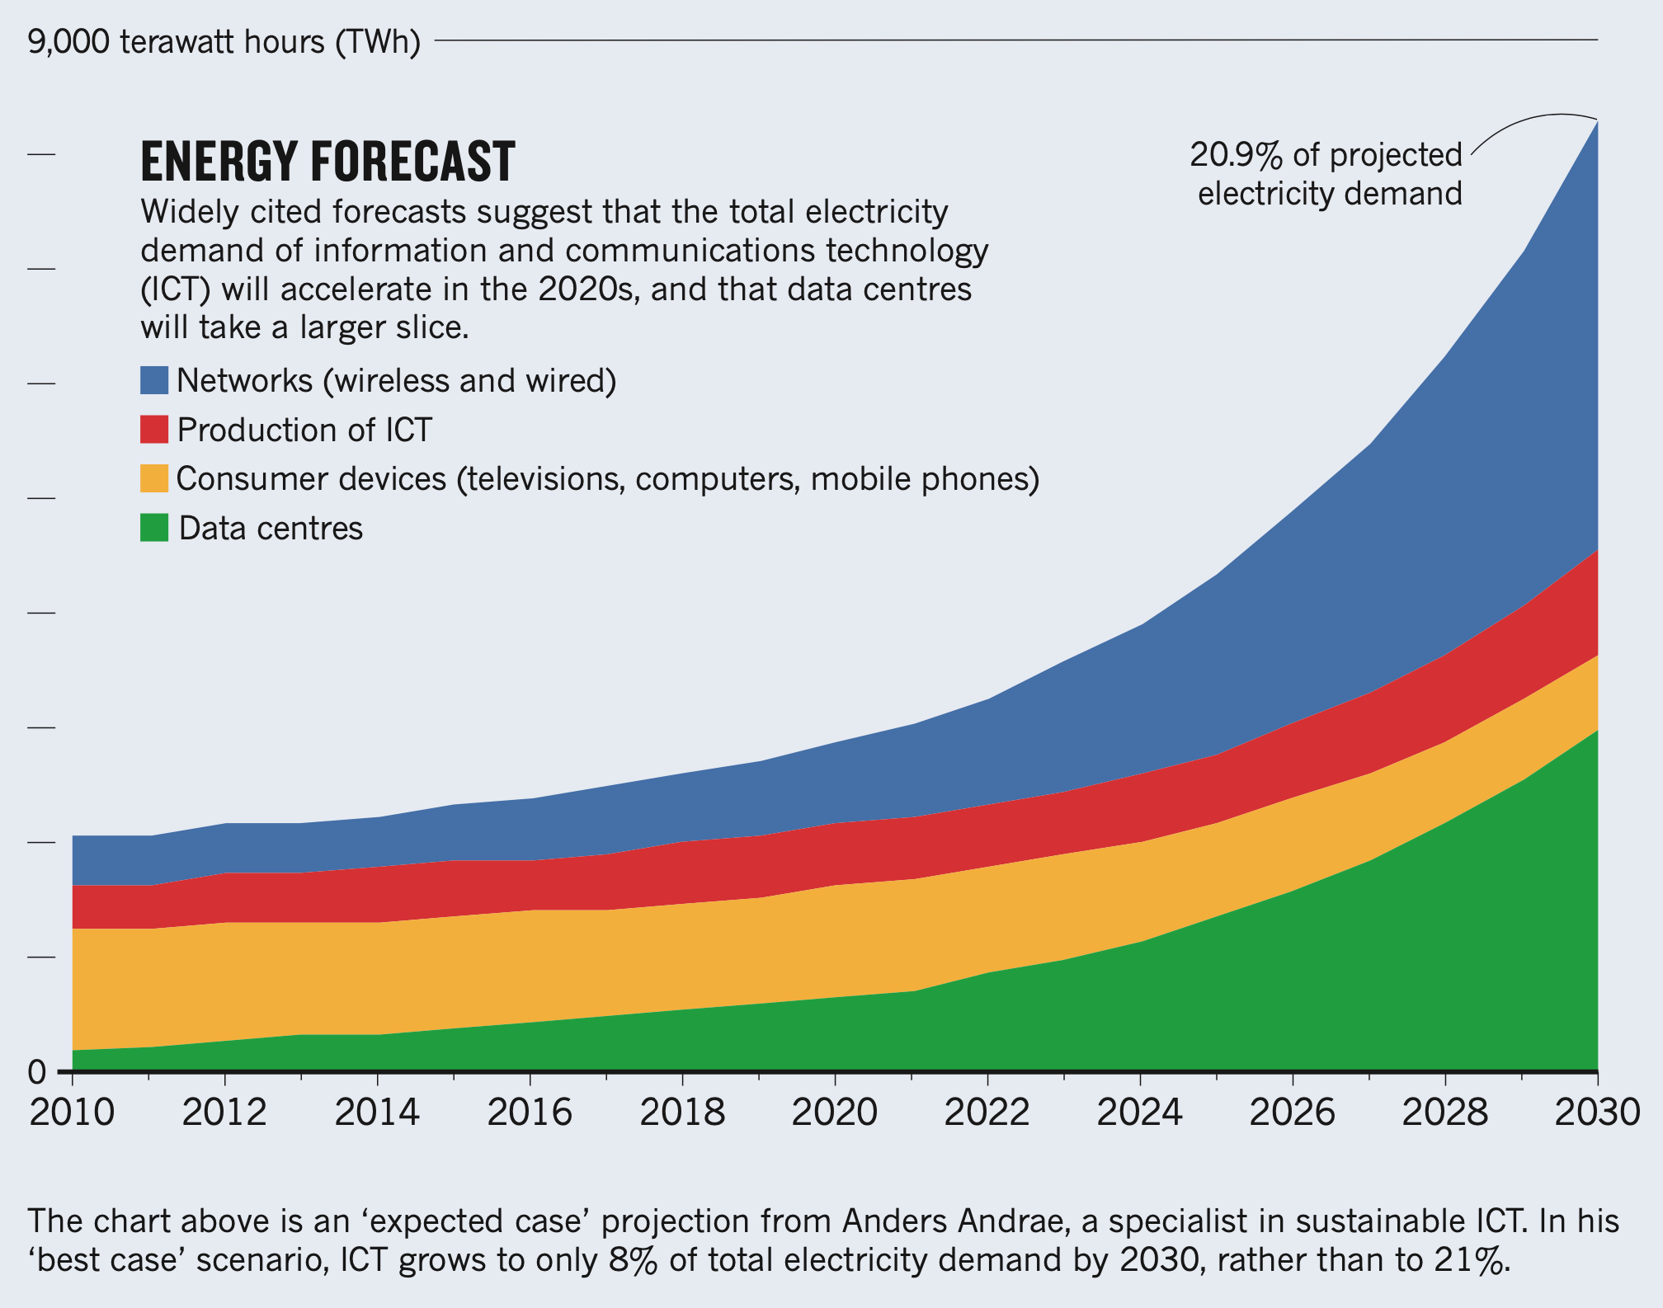

ICT/Data center energy forecast
Data centre energy usage:
~ 200 TWh for data centres in 2018
~ 3000 TWh in 2030
Dutch Data Center Usage (2019)
1300 MW installed capacity
0.3 % electricity usage of the Netherlands (CBS)
3x as much power than the NS
Jones, Nicola. "How to stop data centres from gobbling up the world’s electricity." Nature 561.7722 (2018): 163-166.
Andrae, Anders SG, and Tomas Edler. "On global electricity usage of communication technology: trends to 2030." Challenges 6.1 (2015): 117-157.
Bakkeren, Hanno. "Datacenters verbruiken drie keer zoveel stroom als de NS". NRC, 14 May 2019
State of the Dutch Data Centers, The Dutch Data Center Report, 2022, https://www.dutchdatacenters.nl/

Slide 6
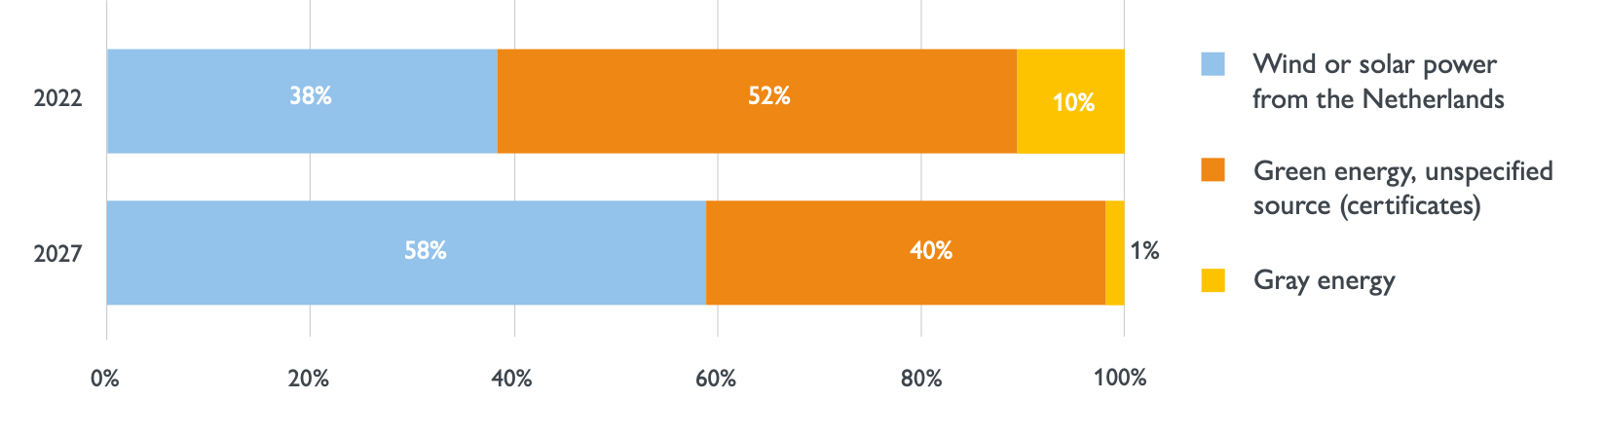
ICT/Data center energy forecast
Data centre energy usage:
~ 200 TWh for data centres in 2018
~ 3000 TWh in 2030
Dutch Data Center Usage (2019)
1300 MW installed capacity
0.3 % electricity usage of the Netherlands (CBS)
3x as much power than the NS
Dutch Data center energy consumption (2022)
90% of all energy consumed by colocation data centers is green.
Jones, Nicola. "How to stop data centres from gobbling up the world’s electricity." Nature 561.7722 (2018): 163-166.
Andrae, Anders SG, and Tomas Edler. "On global electricity usage of communication technology: trends to 2030." Challenges 6.1 (2015): 117-157.
Bakkeren, Hanno. "Datacenters verbruiken drie keer zoveel stroom als de NS". NRC, 14 May 2019
State of the Dutch Data Centers, The Dutch Data Center Report, 2022, https://www.dutchdatacenters.nl/

Slide 7
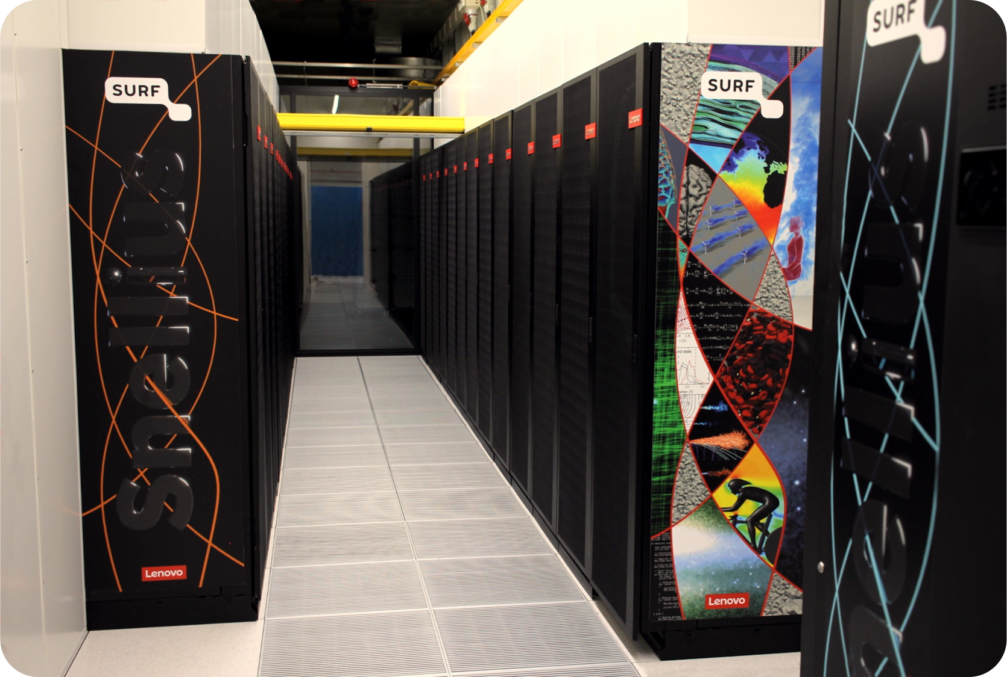
Snellius - Dutch National supercomputer
#254 (Phase 1 GPU) in TOP500 list (Nov 2022)
#36 Green500 (Phase 1 GPU Nov 2022)
#6 Green500 (Phase 1 GPU Nov 2021)
CPU partitions (AMD EPYC™ 7H12, 2x 64 cores/socket):
522 thin nodes (256 GiB)
72 Fat nodes (1 TiB)
4 high memory (2x 8 TiB, 2x 4 TiB)
GPU partition (4x NVIDIA A100 GPUs):
72 GPU (Intel Xeon Platinum 8360Y (2x) hosts)
(#374) CPU: LINPACK Rmax (0.5 MW) 2.13 PFlop/s
(#176) GPU: LINPACK Rmax (0.13 MW) 3.6 PFlop/s
Notes:
It so happens that such workloads occur very often in scientific applications.
GPUs have become really the main source of compute power in big supercomputers.
This is for example the Frontier supercomputer, the fastest supercomputer in the world right now and it contains four GPUs for every CPU.
Even 7 out of 10 systems in the top10 are GPU-based supercomputers. But, there are still quite a lot of scientific applications that are not yet able to run on GPUs.
So the main problem is: how to program these GPUs for things that aren’t computer graphics?

Slide 8
Top 500 (Nov-2022)
Frontier (21.1 MW) 1,102.0 PFlop/s
Fugaku (29.9 MW) 442.01 PFlop/s
LUMI (6.0 MW) 309 PFlop/s
Leonardo (5.6 MW) 174 PFlop/s
Summit (10.1 MW) 148 PFlop/s
Snellius
(#374) CPU: LINPACK Rmax (0.5 MW) 2.13 PFlop/s
(#176) GPU: LINPACK Rmax (0.13 MW) 3.60 PFlop/s
Notes:
It so happens that such workloads occur very often in scientific applications.
GPUs have become really the main source of compute power in big supercomputers.
This is for example the Frontier supercomputer, the fastest supercomputer in the world right now and it contains four GPUs for every CPU.
Even 7 out of 10 systems in the top10 are GPU-based supercomputers. But, there are still quite a lot of scientific applications that are not yet able to run on GPUs.
So the main problem is: how to program these GPUs for things that aren’t computer graphics?

Slide 9
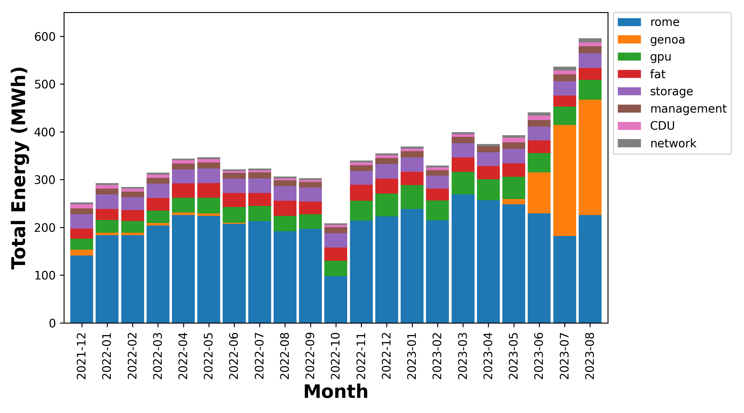
Snellius - Total Energy Usage
Snellius in August used ~ 600MWh of energy.
~2500 house holds worth

Slide 10
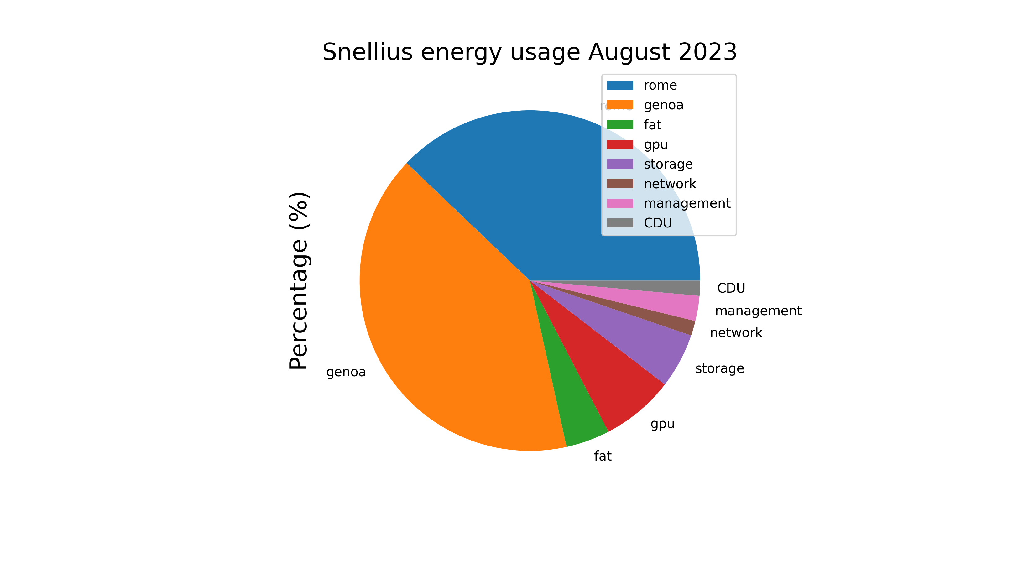
Snellius - Energy usage per partition
90% Compute
80% CPU
39% Rome
41% Genoa
7% Gpu
3% Fat
10% Other
5.0% Storage
2.4% Management
1.5% Cooling
1.1% Network

Slide 11
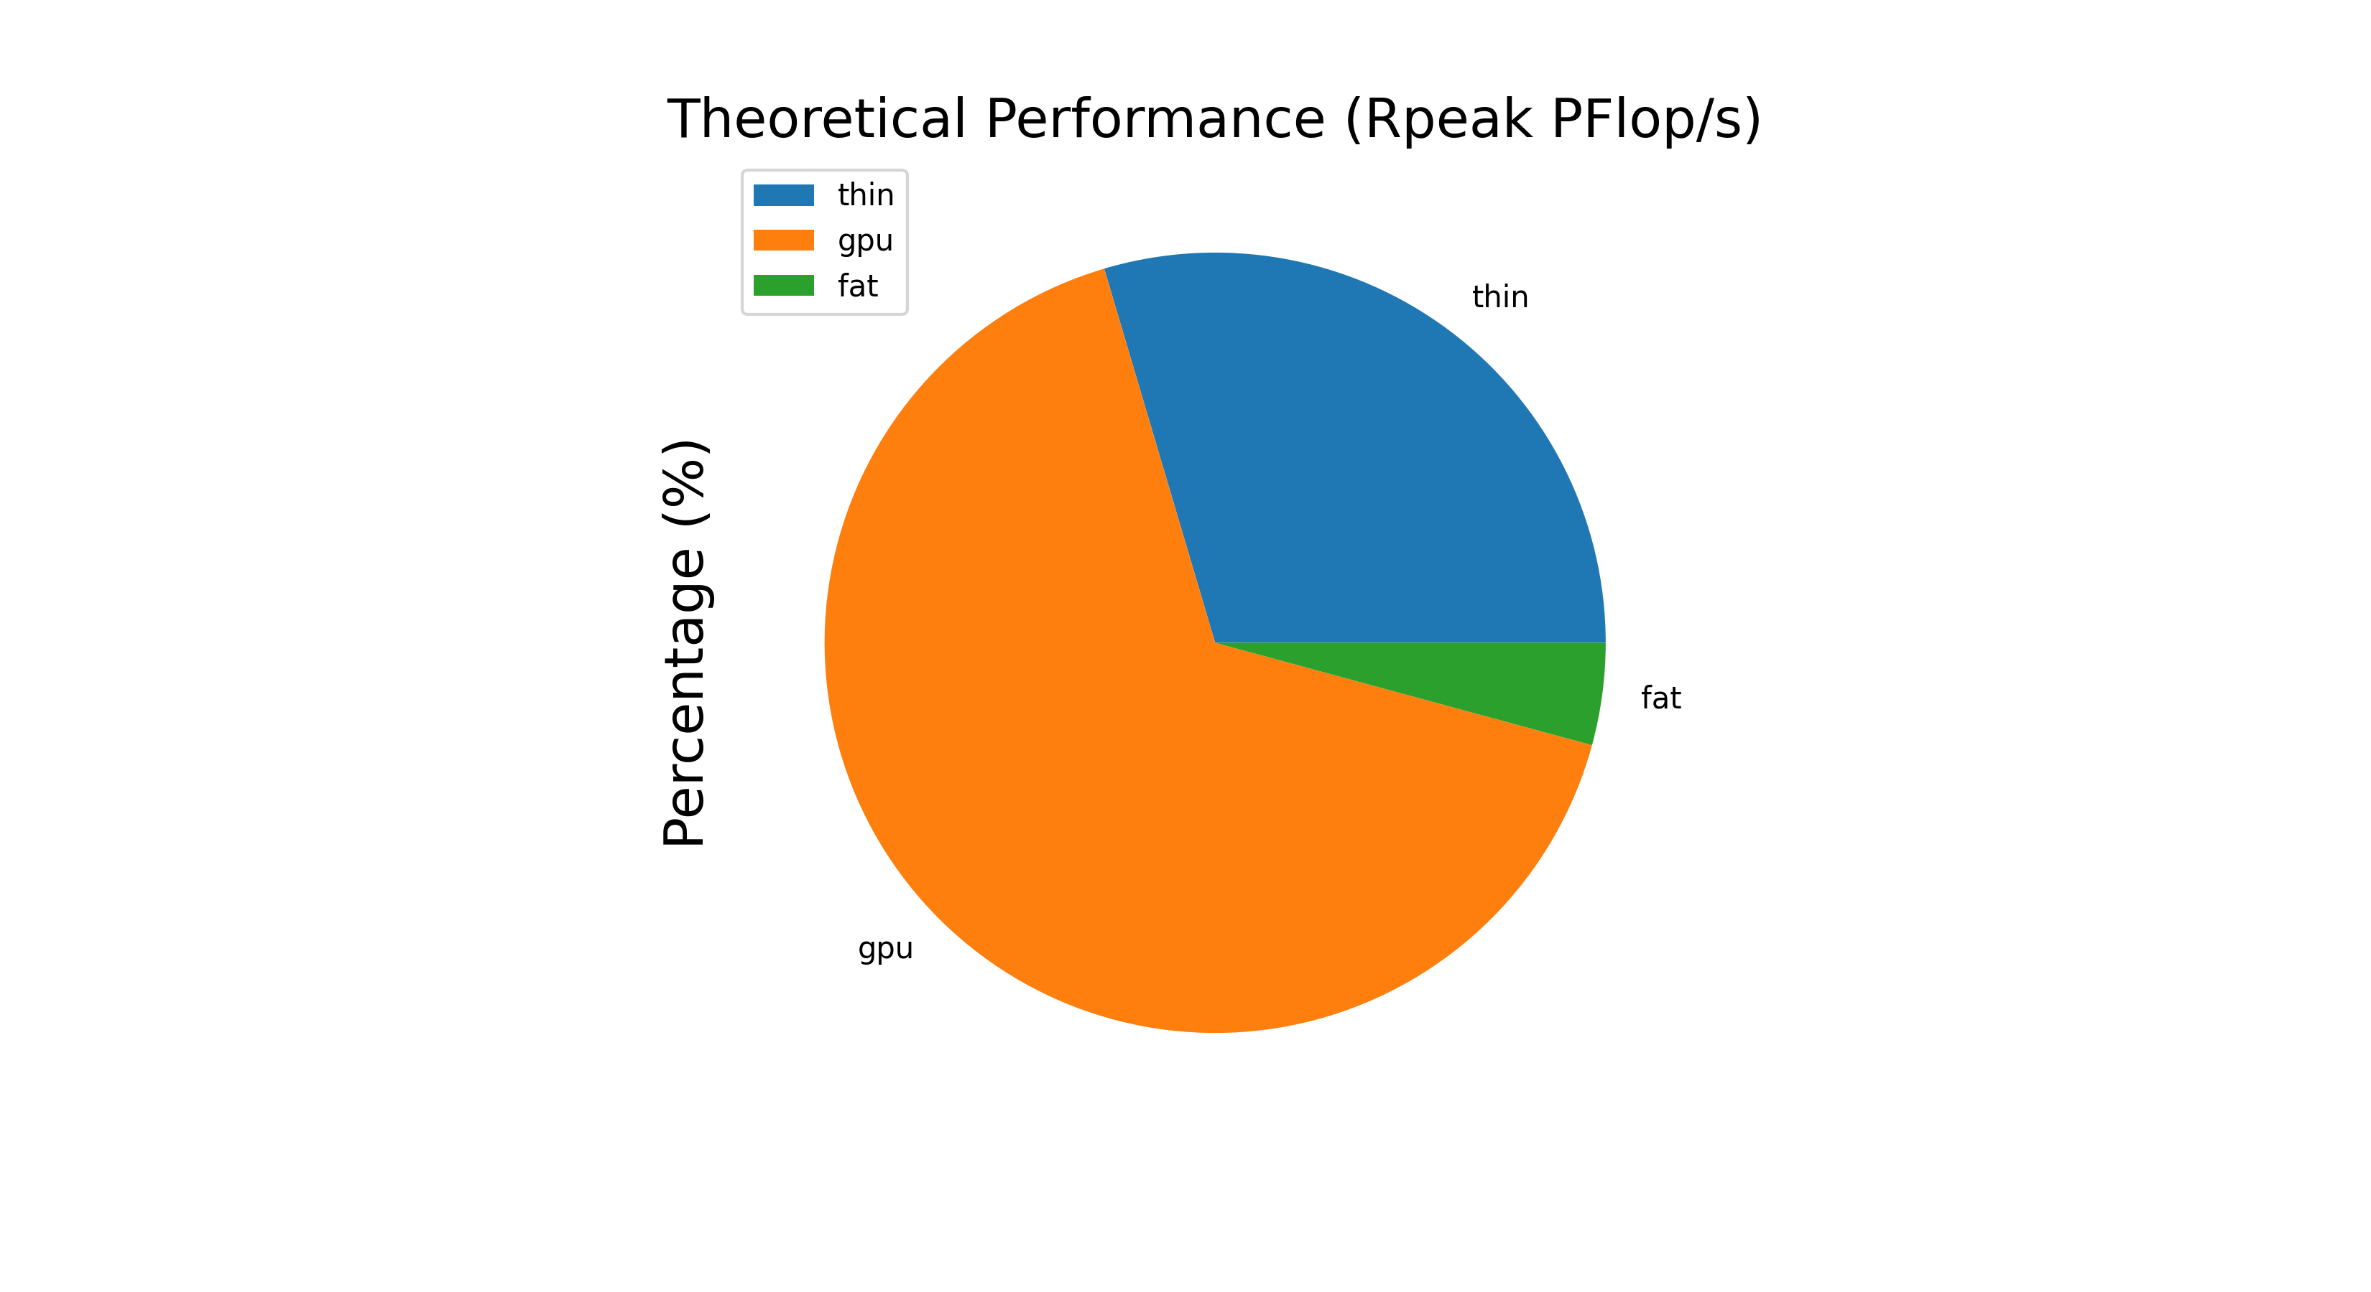
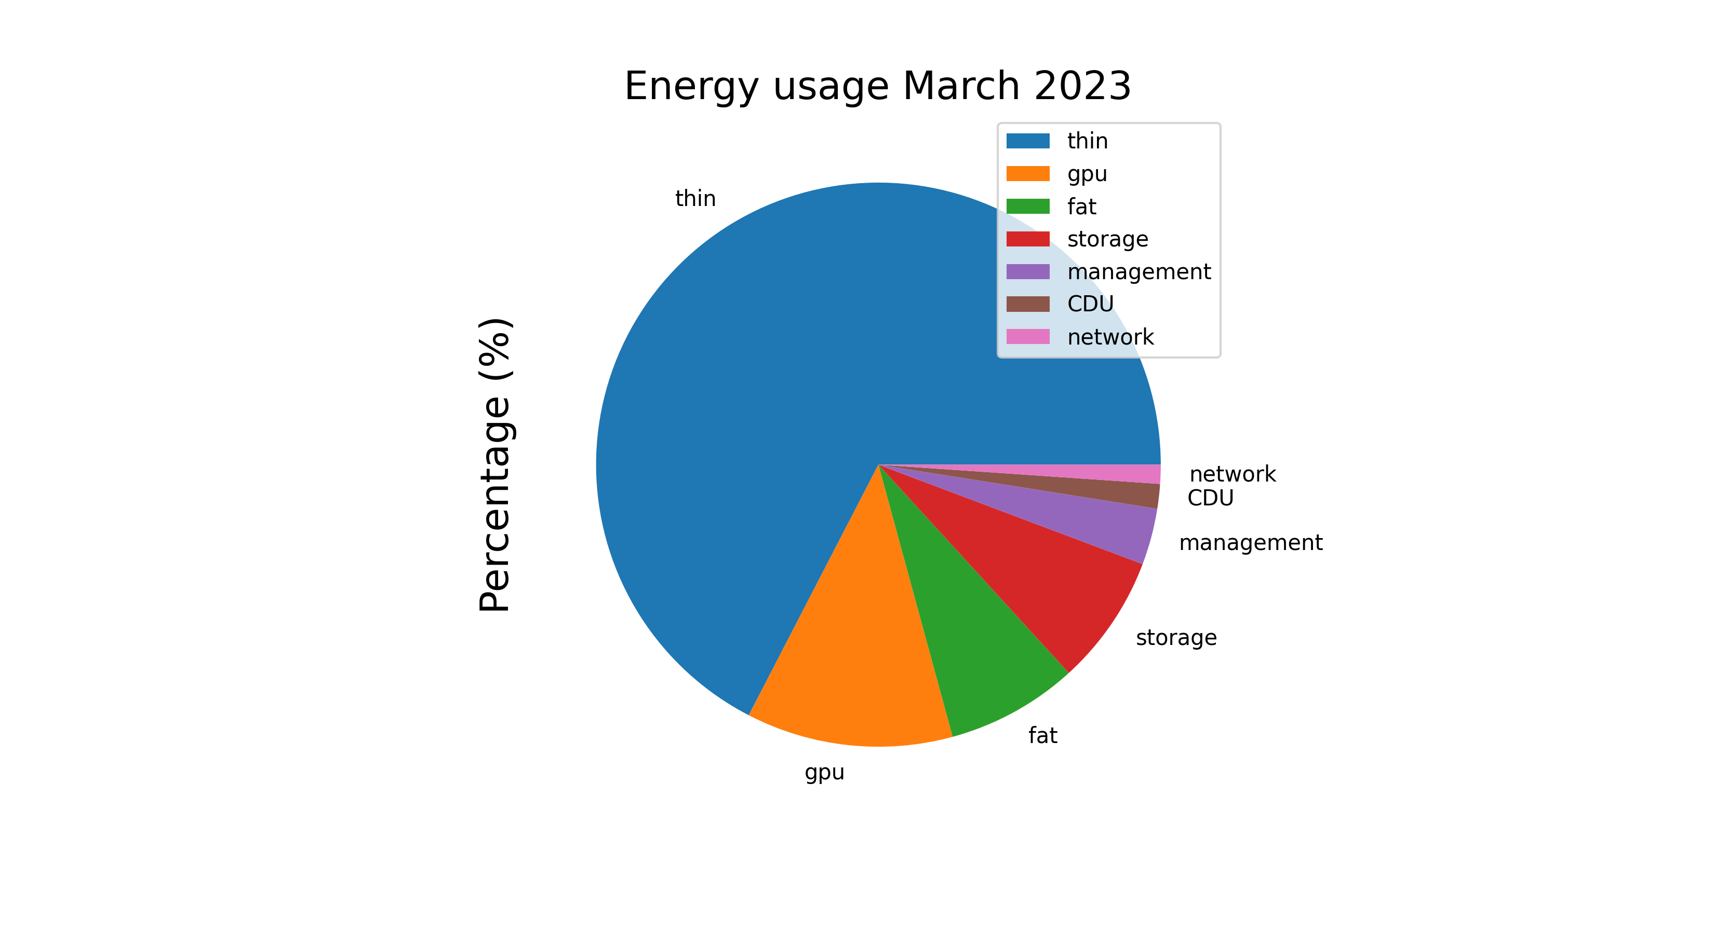
Performance vs Energy
Thin (Rpeak) – 2.86 PFlops
Fat (Rpeak) – 0.38 PFlops
GPU (Rpeak) – 6.01 Pflops
Thin – 269 MWh
Fat – 30 MWh
GPU – 47 MWh

Slide 12
Performance vs Energy
GPU ~ same compute for 1/5 the energy (March 2023)

Slide 13

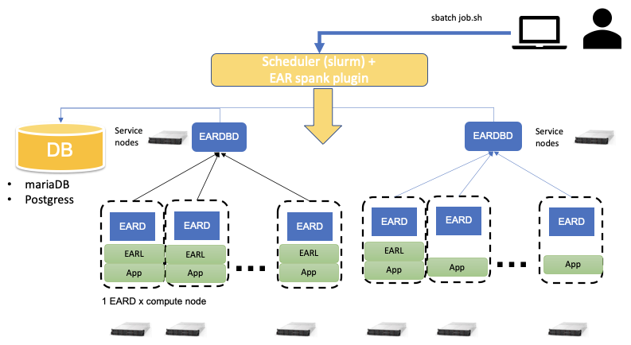

Energy Aware Runtime (EAR) Energy Aware Runtime (EAR) package provides an energy management framework for super computers.
Notes:
WL 20210415 Snellius
WL 20210218

Slide 14

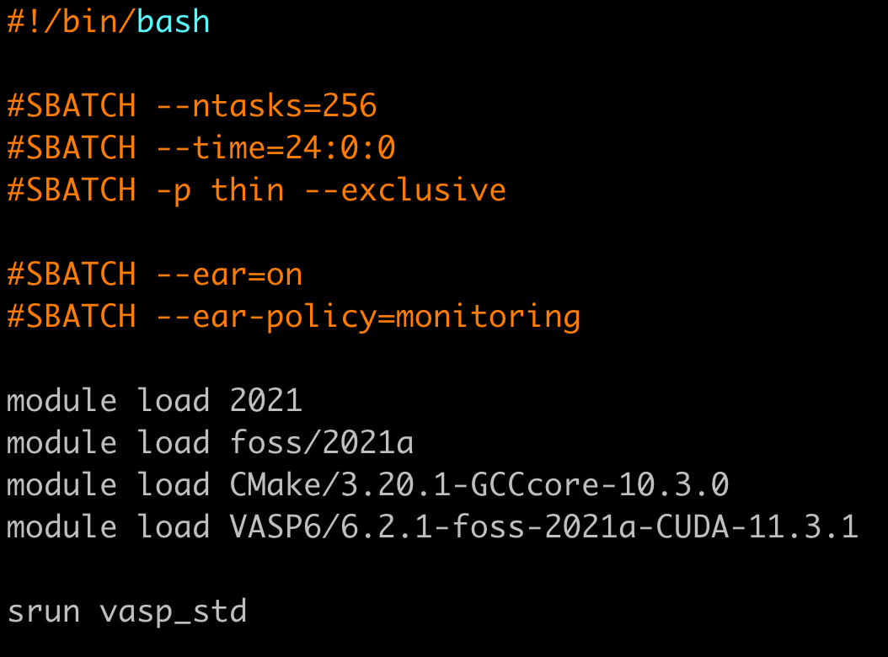
Energy Aware Runtime (EAR) Energy Aware Runtime (EAR) package provides an energy management framework for super computers.
EAR Node Manager (EARD) “Daemon”
Energy metrics via the RAPL (Running Average Power Limit) function
Global energy limits or just offer global cluster monitoring
EARL is a library that is loaded next to the application
Offers application metrics monitoring
Can select the frequencies based on the application behavior on the fly.
Integrated with SLURM on Snellius.
Intercepts the MPI symbols through the PMPI interface to provide “traces” of MPI applications.

Slide 15
Energy Aware Runtime (EAR) Energy Aware Runtime (EAR) package provides an energy management framework for super computers.
EAR Node Manager (EARD) “Daemon”
Energy metrics via the RAPL (Running Average Power Limit) function
Global energy limits or just offer global cluster monitoring
EARL is a library that is loaded next to the application
Offers application metrics monitoring
Can select the frequencies based on the application behavior on the fly.
Integrated with SLURM on Snellius.
Intercepts the MPI symbols through the PMPI interface to provide “traces” of MPI applications.

Slide 16
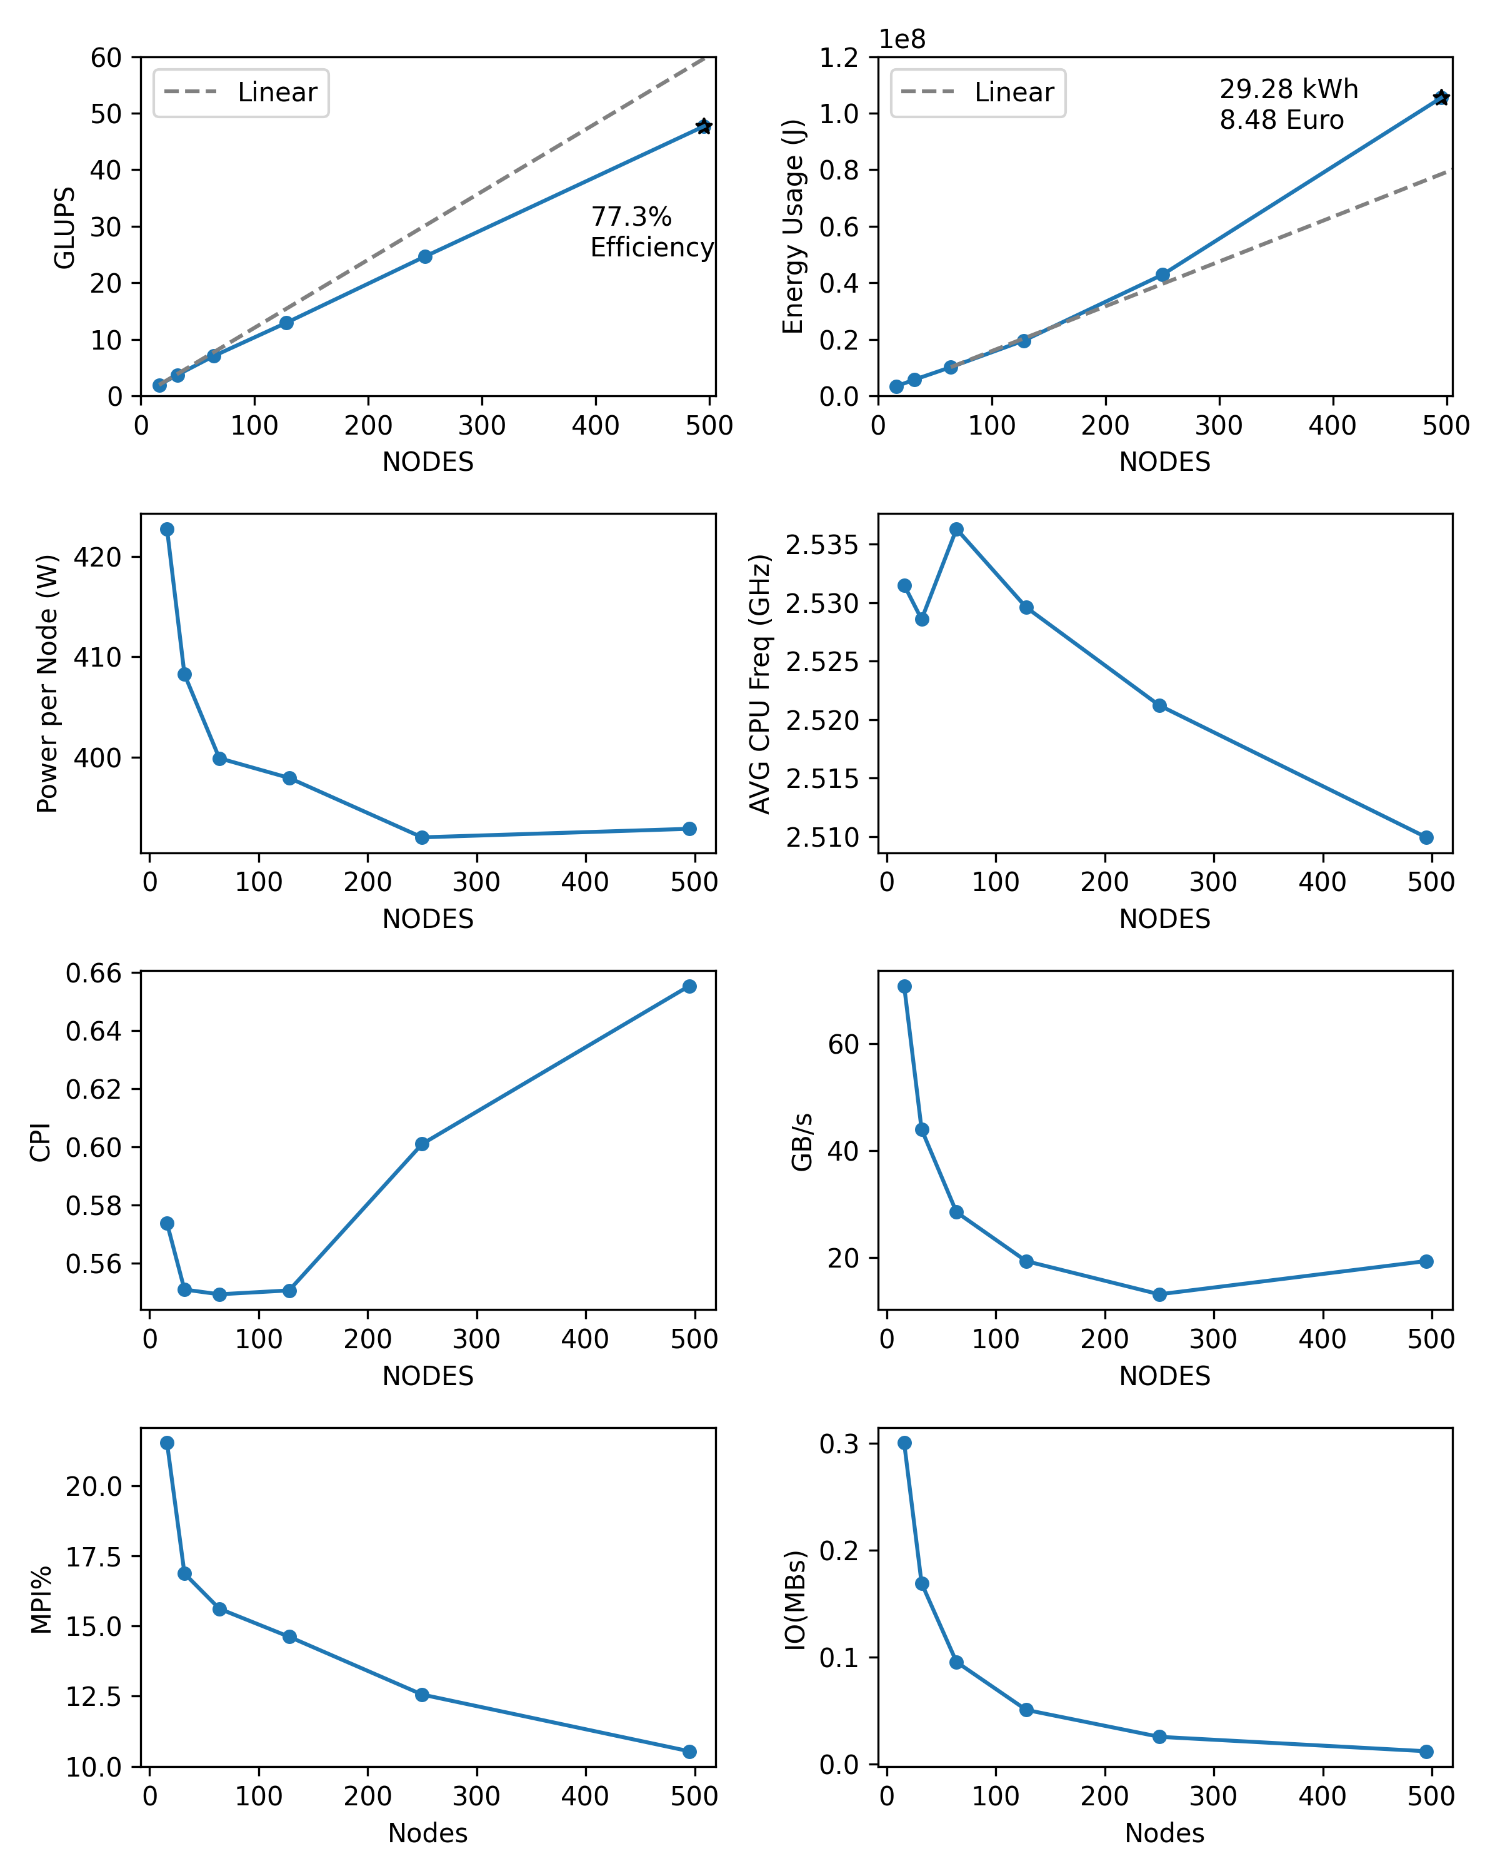

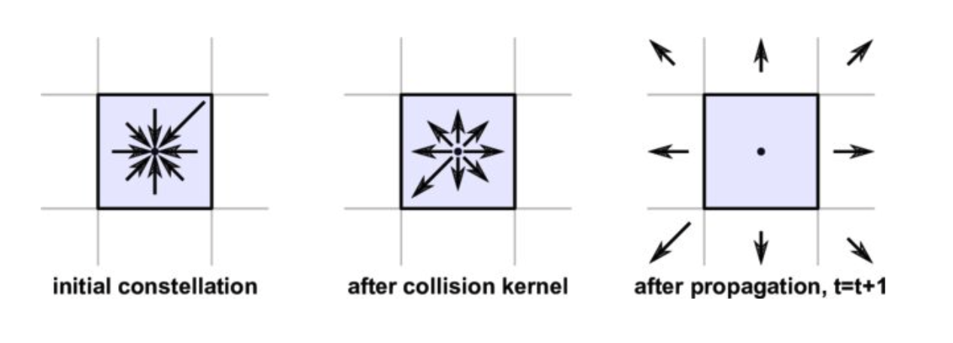


Palabos: Lattice-Boltzmann Solver Strong Scaling Benchmark
J. Latt, O. Malaspinas, D. Kontaxakis et al. / Computers and Mathematics with Applications 81 (2021) 334–350

Slide 17
Palabos: Lattice-Boltzmann Solver Strong Scaling Benchmark
An average electric car consumes about 0.2 kwh/km
495 node case (which ran for 9 minutes) just drove a car to Leeuwarden (149km from SP)!

Slide 18
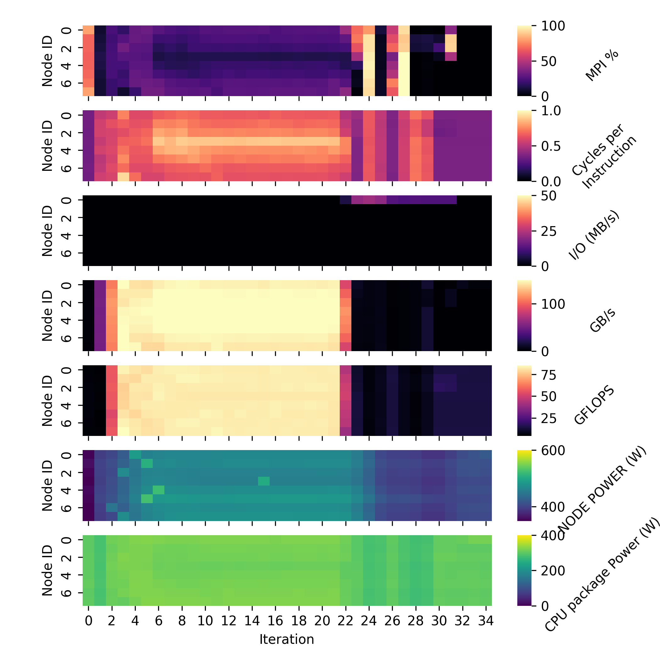
Palabos: Strong Scaling Benchmark
Per-node, Per-iteration ”traces”
Node Power
Avg CPU Freq (node)
Main memory BW (GB/s)
CPI (Cycles per instruction)
MPI% (percentage spent in MPI calls)
I/O (network communication)

